Slide 1
Research Mid-review Presentation
Analysis & Development of Dynamic TLPs in the use of Smart Mobile Device Communication
Project ID: 15-019

Slide 2
What we intended to do
To design an enhanced dynamic transport layer protocol which is different to the conventional TLPs

Slide 3






Slide 4
How
Our research is based on the study of TCP, UDP protocols and trying to analyse the components that support faster communication through the Transport Layer and implementing a dynamic transport layer protocol

Slide 5
Drawbacks of TCP opposed to the proposed Dynamic TLP
It cant identify the data type and adjust according to the same.
Identify urgent data and prioritizing
TCP provides reliability by process to process connection establishment, flow control, error control, congestion control and finally connection termination, how ever when it comes to urgent data we would not need the same attention.
TCP is well suited to transferring large amount of data. However for smaller amount of application layer data, TCP can impose considerable overhead leading to significant additional delay effecting data transfer efficiency

Slide 6
Aim
Study of the header of TCP to suite the data coming from the application layer and possibility of advancing it according to the type of data.
Study of the possibility of sending out request via the SYN and receive the data from severs through the ACK via the 3 way handshake without having to wait for the connection establishment
Study of different methods to be invoked in TCP when transferring data according to their type ie.GPS, WiFi, and arranging a single acknowledgement for similar data requests

Slide 7
Steps that were taken
Analyzing different data types
Analysis of different protocols in the transport layer
Implementation of Dynamic TCP Header
Execution of Methods in TCP to suite the Dynamic TLP – Congestion Control
Possibility of sending a single ACK for several sequential requests
Sending data along with the three way handshake to improve efficiency.

Slide 8
Analyzing different data types
Data | Size | Transmission Frequency | Delivery Reliability | Direction | Network
GPS - Processed | Very Small | High | No | C → S | I
Wi-Fi - Processed | Very Small | High | No | C → S | I
Obstacle - Fixed | Medium | Triggered | Yes | C → S | I
Obstacle – non stationary | Small | Urgent | Yes | C → S C → C | A, I
Map Data | Large | Triggered | Yes | S → C, C → S | I
User Location | Very Small | High | No | C → S C → C | A, I
Sensor data -Processed | Very Small | High | No | C → S | A, I
Instruction | Small | Urgent | Yes | S → C C → C | A, I

Slide 9
Analysis of different protocols in the transport layer
 | TCP | UDP | DCCP | SCTP
Connection Oriented | Yes | No | No | No
Reliable | Yes | No | No | Yes
Congestion Control | Yes | No | Yes | Yes
Ordered/Unordered delivery | Ordered | Unordered | Unordered | Both
Retransmission flow | End to End | End to End | End to End | End to End

Slide 10
Implementation of Dynamic TCP Header

Slide 11
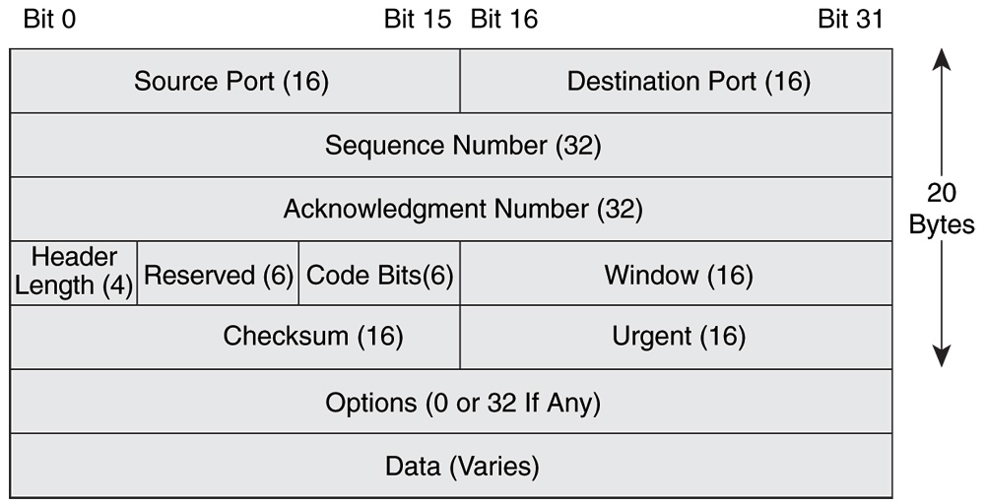
Why?
TCP adds 20 bytes of standard header and up to 60 bytes with options [1].
Well suited to transferring large amount of data.
Standard TCP Header

Slide 12
Why?
The mobile device of the vision impaired person will capture the GPS, Wi-Fi and sensor data depending on availability and processed data will be send client to server. [Urgent Data]
This data has very small payload.
However for smaller amount of application layer data, TCP can impose considerable overhead leading to significant additional delay effecting data transfer efficiency [2].
Data | Size | Transmission Frequency | Delivery Reliability | Direction | Network
GPS - Processed | Very Small | High | No | C -> S | I
Wi-Fi – Processed | Very Small | High | No | C -> S | I
Sensor data – Processed | Very Small | High | No | C -> S | A, I
C – Client, S – Server, A – Adhoc, I - Infrastructure

Slide 13

Solution??
Develop a Dynamic TCP Header.
Which changes it’s size according to data coming from application layer.
Urgent data TCP header < 20 bytes
Non-urgent data TCP header = 20 bytes

Slide 14

How?
Removing non-critical information from standard TCP header.
Thus, reduces size of header.
Need to define a new header structure.

Slide 15
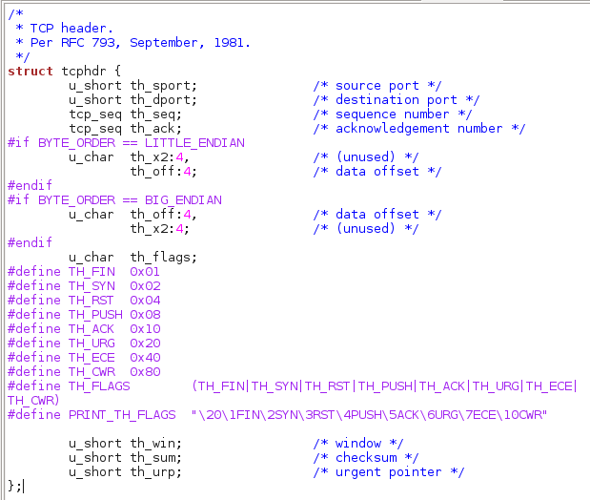
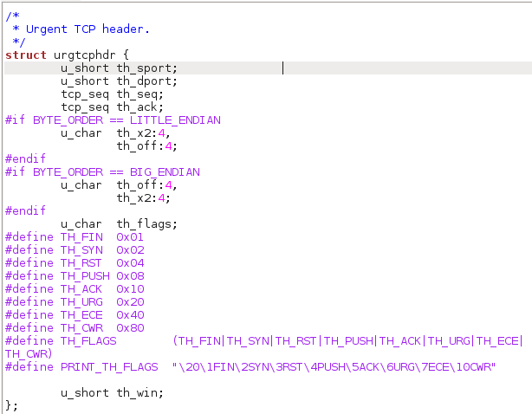
How?
Standard TCP header
Urgent TCP header

Slide 16
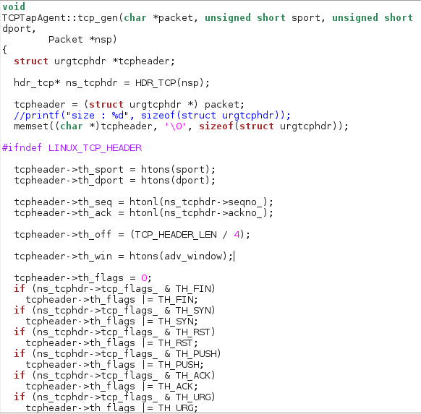
How?
Implementation of tcp_gen() function.
Generates a new TCP segment.
Newly implemented TCP header is used.
Values are assigned to it’s fields.
New header is being used
Assignment of header data

Slide 17
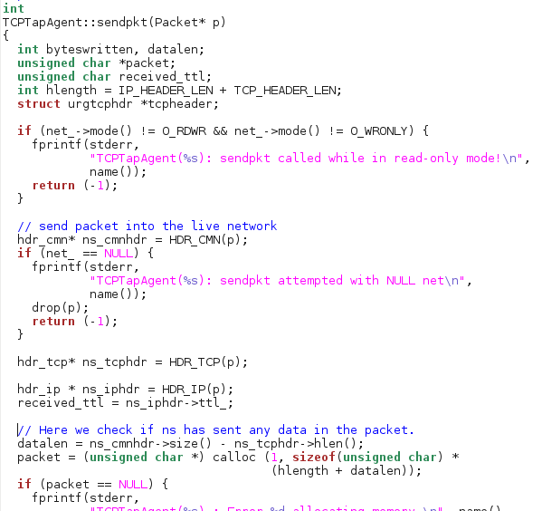
How?
sendpkt() function
Sends network packet to the live network.

Slide 18
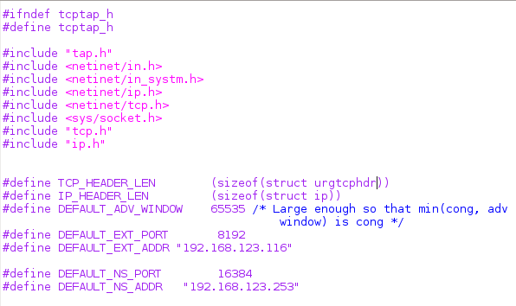
How?
New length for the Urgent TCP header is calculated.

Slide 19
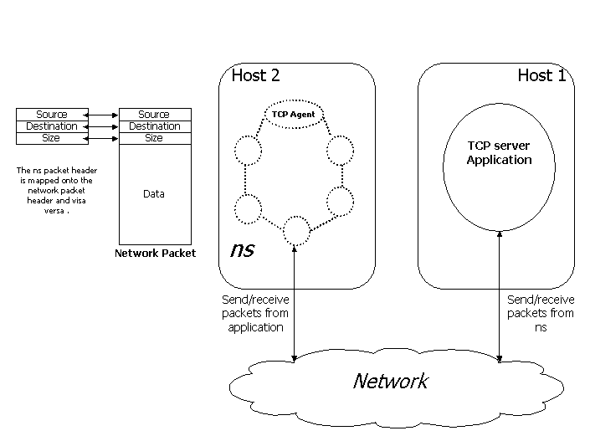
How? – Emulation in NS2
but are not intended to be faithful replicas of real-world TCP implementations. They do not contain a dynamic window advertisement, there is no SYN/FIN connection establishment/teardown, and no data is ever transferred (e.g. no checksums or urgent data). [Source : NS2 Documentation]
Hence, Emulator functionality of ns2 had to be used.
Maps ns2 packet header into the network packet header.
Injects it into a live network.
Which will be consumed by a TCP server in another host.

Slide 20
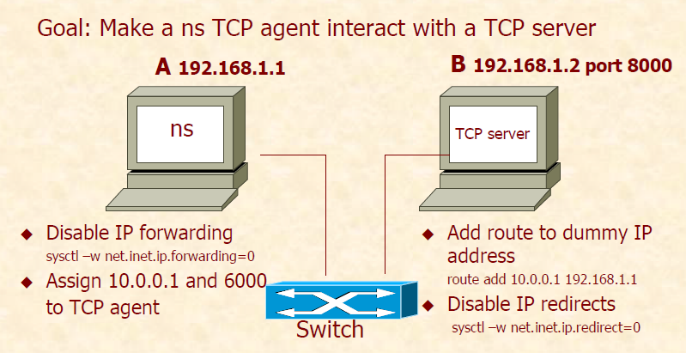
How? – Host Configuration

Slide 21
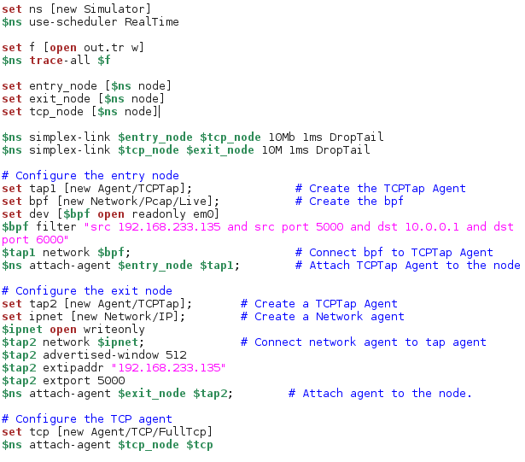
How? – TCL Script
Implementation of the tcl script.
Runs the Emulation.
IP addresses & port numbers of the hosts.

Slide 22
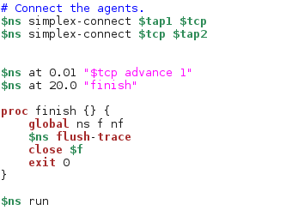
How? – TCL Script

Slide 23
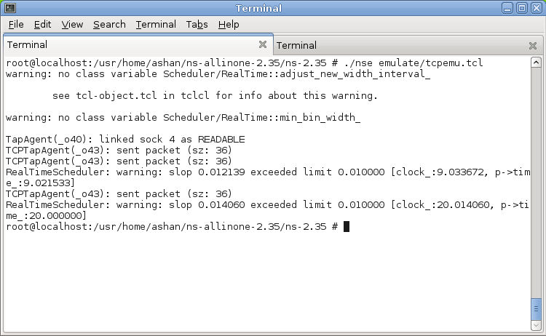
Output
Emulation starts once tcl script is run.
3 packets are sent to the outside network.

Slide 24
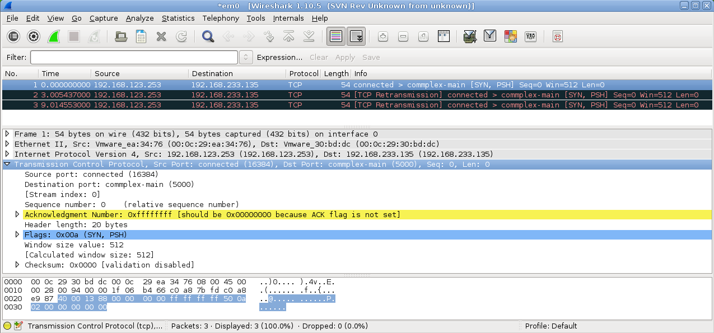
Output – Uses Standard Header
Shows packets captured by Wireshark.
Uses Standard TCP header.
Size is 20 bytes.

Slide 25
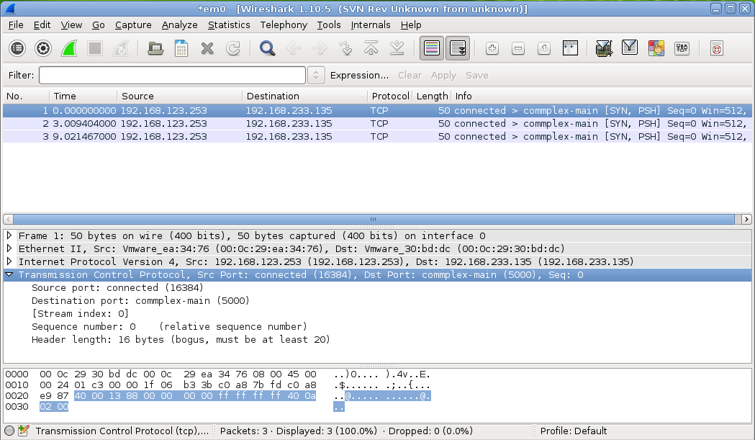
Output – Uses Customized Header
Uses Urgent TCP header.
It is now only 16 bytes in size!

Slide 26

Future Plans – To be Implemented
Further size reduction of Urgent TCP Header.
Switching between standard TCP Header & Urgent TCP header.

Slide 27
Execution of Methods in TCP to suite the Dynamic TLP
Congestion Control

Slide 28
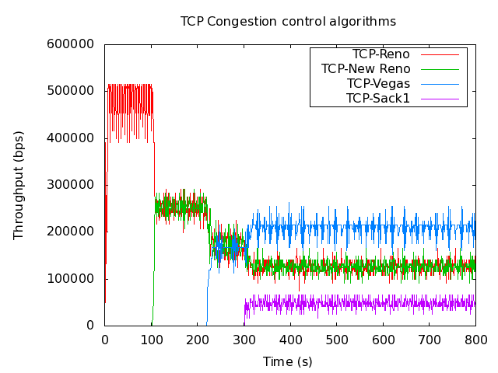
Why
Initial congestion window of a TCP flow is at most 3 segments or about 4Kb of data.
Most Connections are short lived
Initial congestion window is a critical TCP parameter in determining how
quickly flows can finish. [2]
While the global network access speeds
increased dramatically on average in t
he past decade, the standard value of TCP’s
initial congestion window has
remained unchanged.

Slide 29
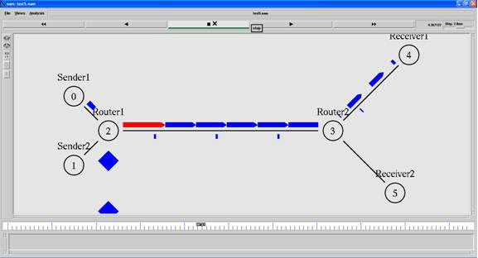
Why
Allow faster recovery from losses. An initial window larger than three segments increases the likelihood that losses can be recovered through Fast Retransmit rather than the longer initial retransmission timeout. Furthermore, in the presence of congestion, the widespread deployment of Selective Acknowledgments (SACK) enables a TCP sender to recover multiple packet losses within a round-trip time. [2]
Before understanding the congestion control, one has to know the congestion window of TCP. TCP has a congestion window (cwnd_ in ns2), this variable affects or predicts the congestion control.
The value assigned to this variable will alter the congestion control.

Slide 30

Solution
Increase TCP’s initial congestion window to at least ten segments, 15KB of data. [2]

Slide 31
How
Investigating the congestion control in TCP
How NS2 handles congestion window size
Output can be shown through a plotted graph

Slide 32
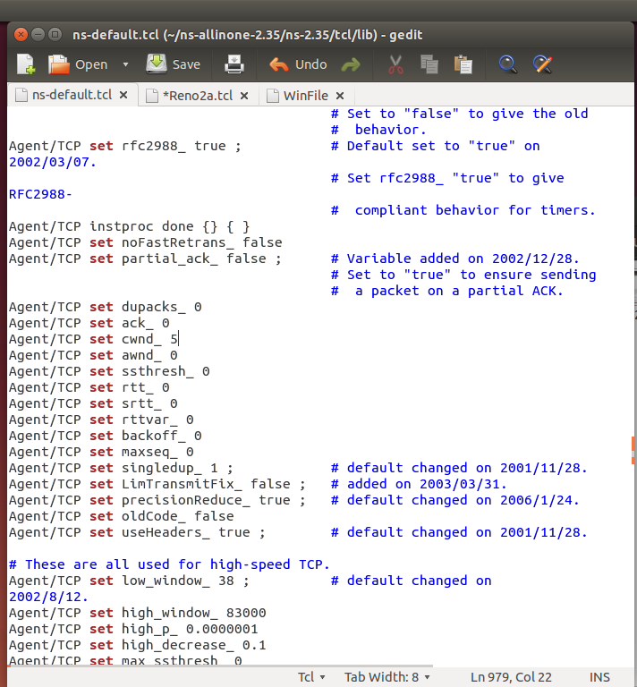
How
Initialize the Congestion Window to 5
In ns-default.tcl, by default cwnd_ is set to 0.
It is now changed to 5.

Slide 33
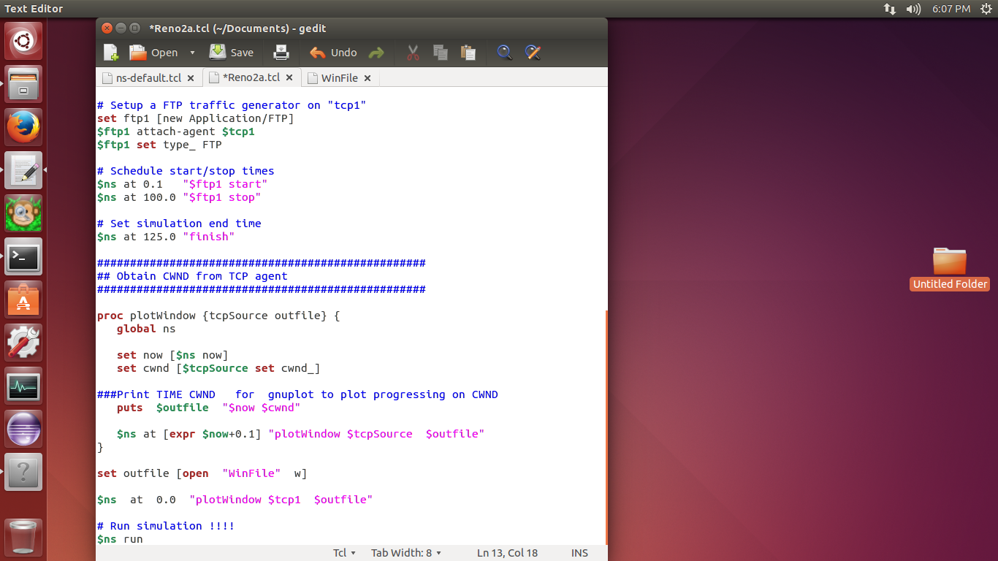
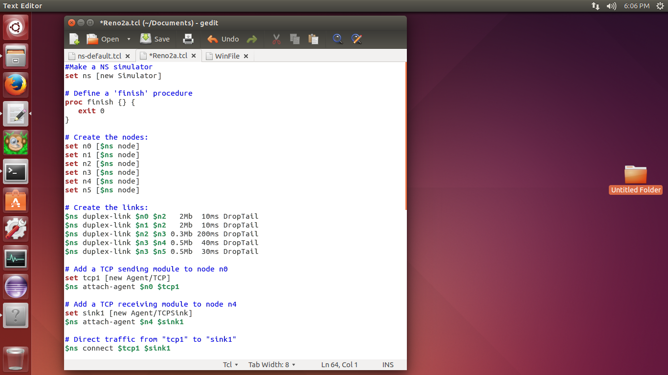
How
Introducing the new procedure to print the congestion window

Slide 34
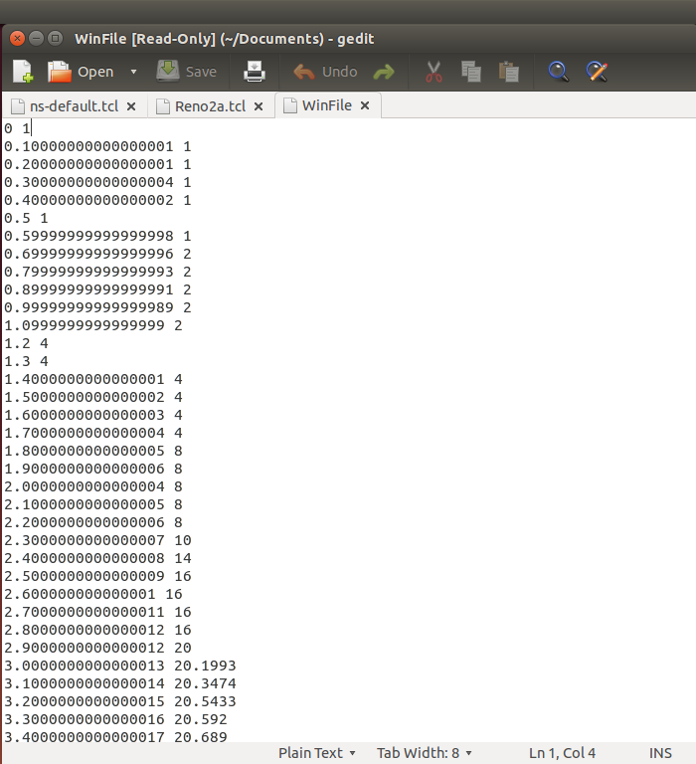
How
When the Win File is running having set the congestion window is to 0.

Slide 35
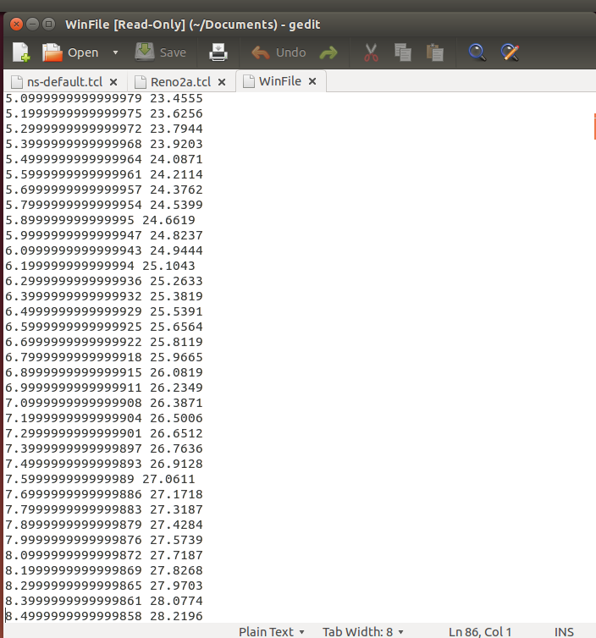
How
When the Win File is running having set the congestion window is to 5.

Slide 36
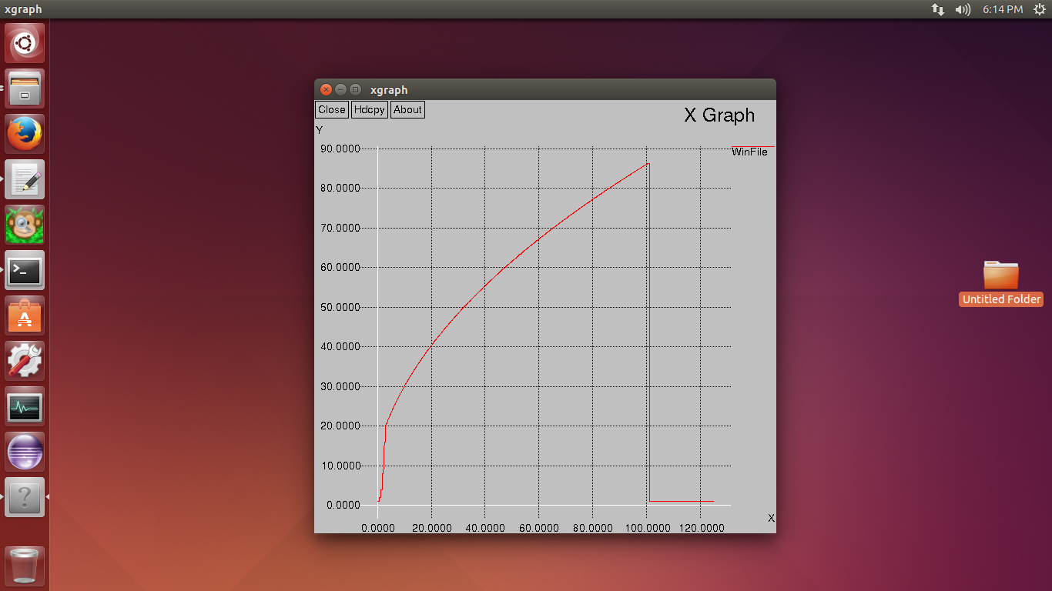
Output
X graph of cwnd_ =0

Slide 37
Output
X graph of cwnd_ initialized = 5

Slide 38
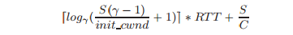
Output
Reduce Latency
[5]
Where S is transfer size, C is bottleneck link-rate, γ is 1.5 or 2 depending on whether acknowledgments are delayed or not, and S/init cwnd ≥ 1. As link speeds scale up, TCP’s latency is dominated by the number of round-trip times (RTT) in the slow start phase. Increasing init cwnd enables transfers to finish in fewer RTTs.
Allow short transfers
To compete fairly with bulk data traffic. Internet traffic measurements indicate that most bytes in the network are in bulk data transfers (such as video), while the majority of connections are short-lived and transfer small amounts of data.

Slide 39

Future Plans – Further Analysis and Developments
Further TCP properties to be looked into (ie. Flow Control, Error Control

Slide 40
A single ACK for several requests

Slide 41
A single ACK for several requests
Server receive several data packets
Instead of sending ACK for each and every packet,
Send one single ACK for all packets
Reorganize the ACK implementation

Slide 42
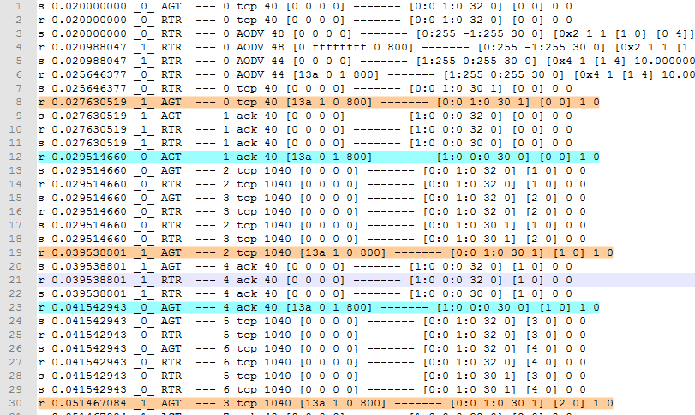
Why do we send single ACK?
TCP data packet
TCP acknowledgement

Slide 43
Why?
Normally TCP send ACK after receiving data packet
If TCP send 100 data packets then receive 1 ACK for each and every data packet
(100 ACK)
In our case
If TCP send 100 data packets then receive 1 ACK
99 ACK packets avoid => Time reduce
Time reduce => End user receive data packet ratio is high

Slide 44
How do we implement?
Analyze the ACK receive handler section in tcp.cc
Avoid duplicate ACK handler
Analyze and reorganize the ACK packet generate section in tcp-sink.cc
Reorganize the ACK Update method
Improve ACK packet transfer ratio
To send single ACK for several requests

Slide 45
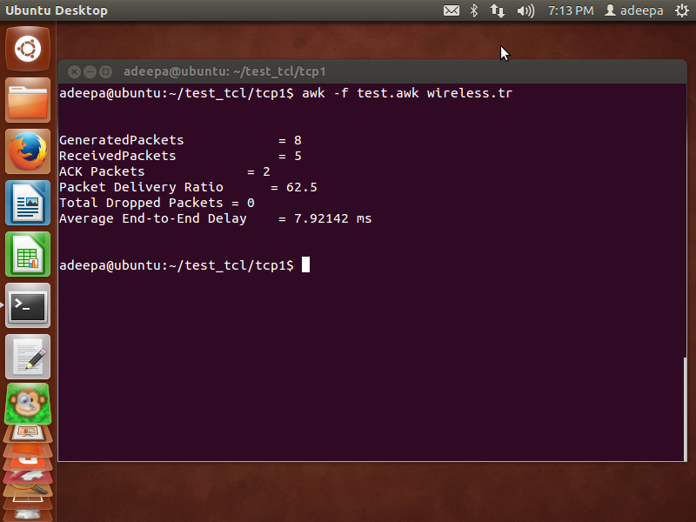
Solution
ACK packets
No dropped packets

Slide 46
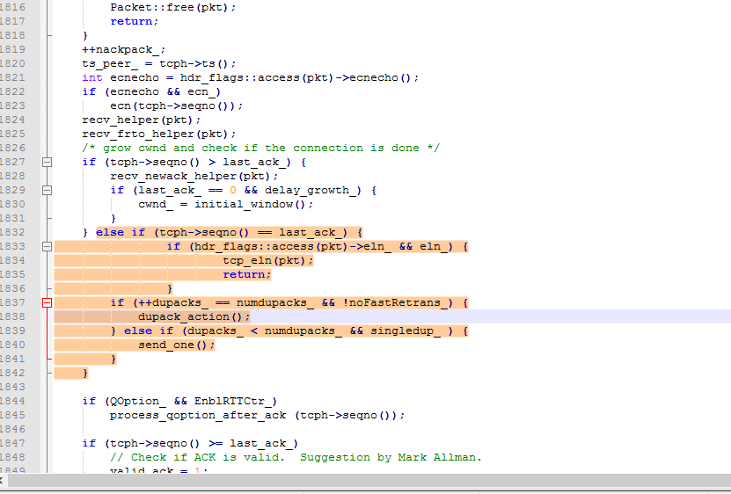
Solution
Since there are no dropped packets we can avoid this section

Slide 47
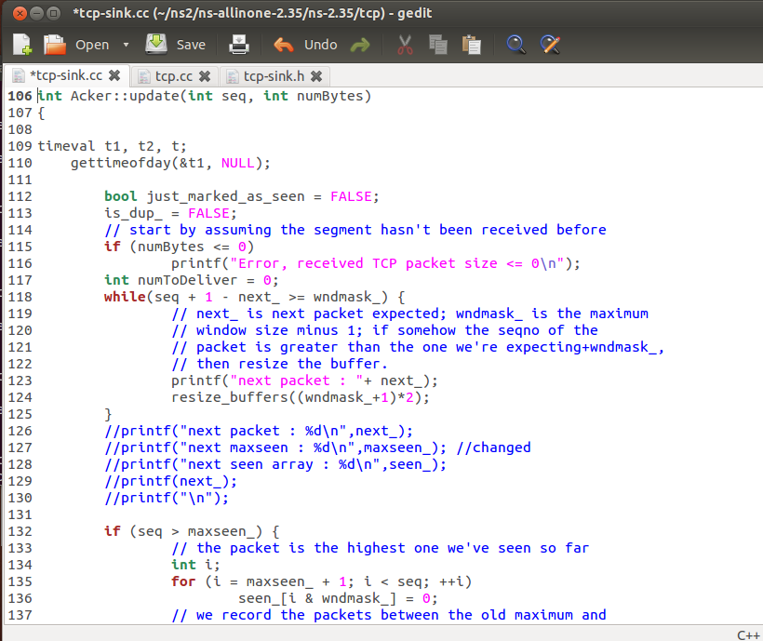
Solution
When TCP receives new ACK
Remove previous assigned ACK
Assign new ACK
Because TCP compare seqno with up coming data packet
Since there are no duplicate packets and dropped packets
Avoid section

Slide 48
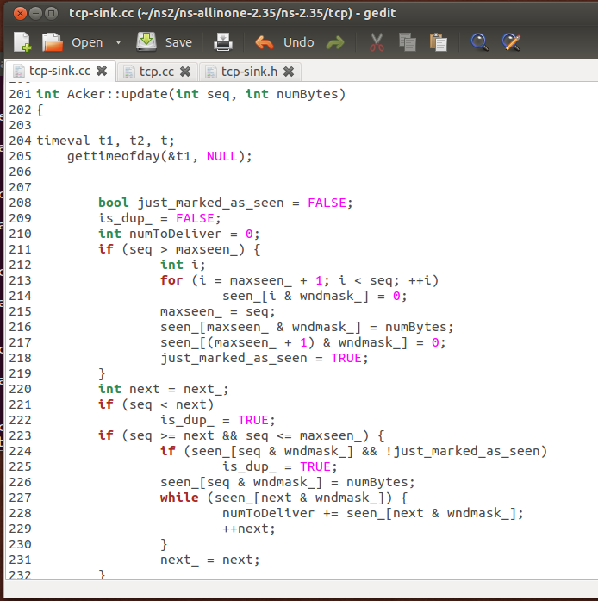
Solution
Reorganized ACK update method
Let’s see execution time difference!!!

Slide 49
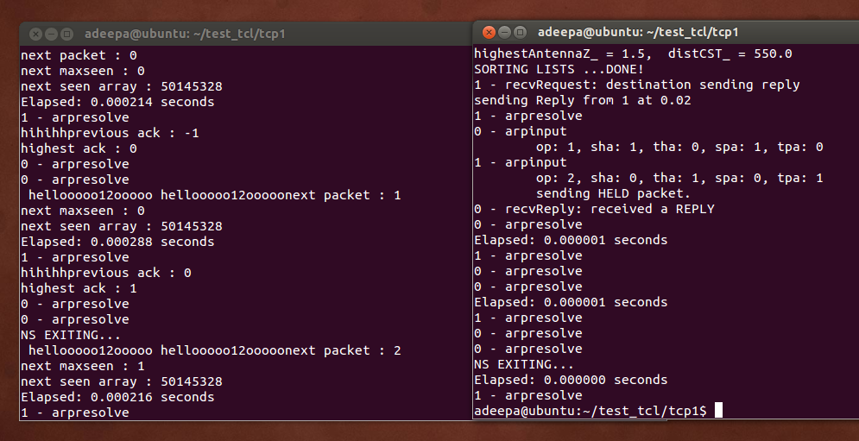
Output
Time taken to execute previous method
Time taken to execute new method

Slide 50
New execution time < Previous execution time
Method execution time reduced
ACK implementation time reduce

Slide 51

Future work
Improving the current implementation for Sending single ACK for several requests further more

Slide 52
Sending data along with the three way handshake to improve efficiency.

Slide 53
Why?
A solution to improve performance on TCP connection by sending data before the connection establishment terminates.
To increase efficiency in order to send data immediately since our protocol is basically focus on specific user groups like vision impaired people. (Reduce time taken to send data)

Slide 54
Solution?
Send data along with the three way handshake.
No need to wait until the three way handshake terminates but rather transferring data while handshake is in progress.

Slide 55
How?
Let the kernel buffer to send some data in the connection establishment process.
This acts as an implicit connect and write at the same time.

Slide 56
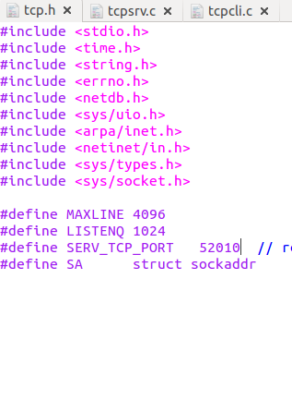
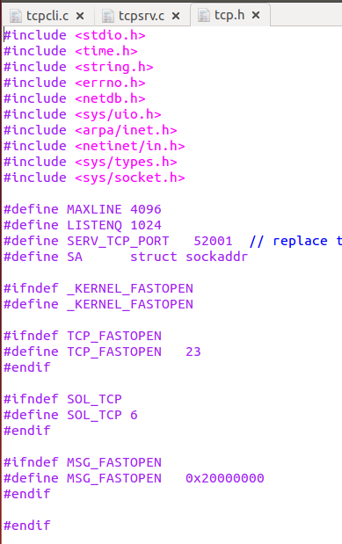
How?
Standard tcp.h
Modified tcp.h

Slide 57
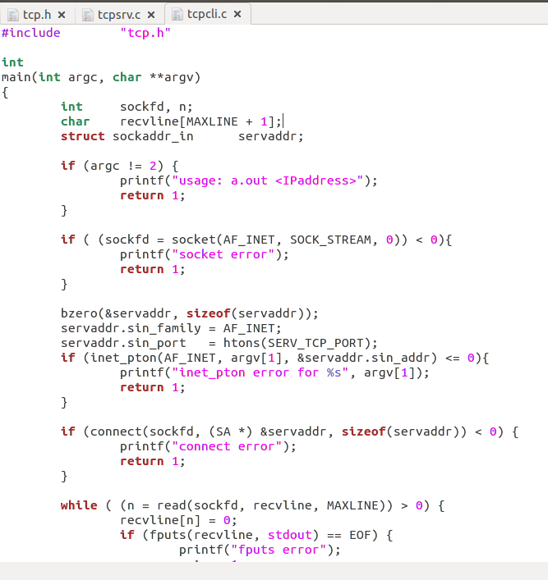
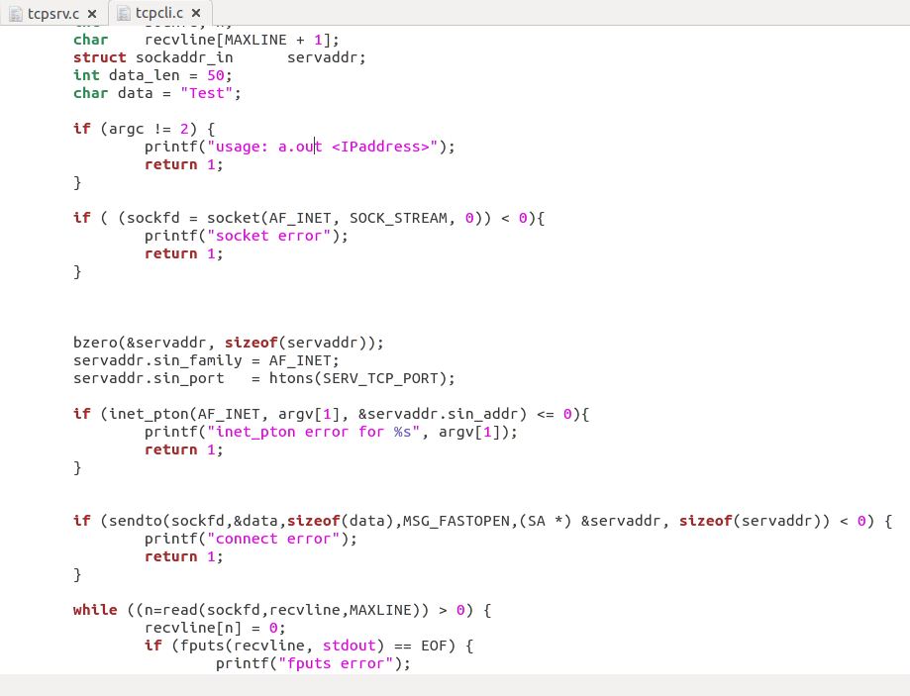
How?
Standard tcpcli.c
Modfied tcpcli.c
Used sendto() call instead of connect(). The call sendto() is like an implicit connect() and send/write() at same time

Slide 58
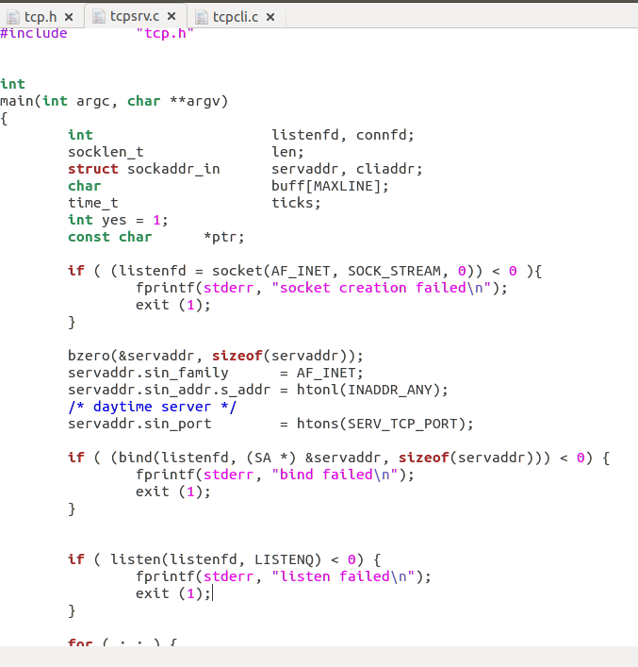
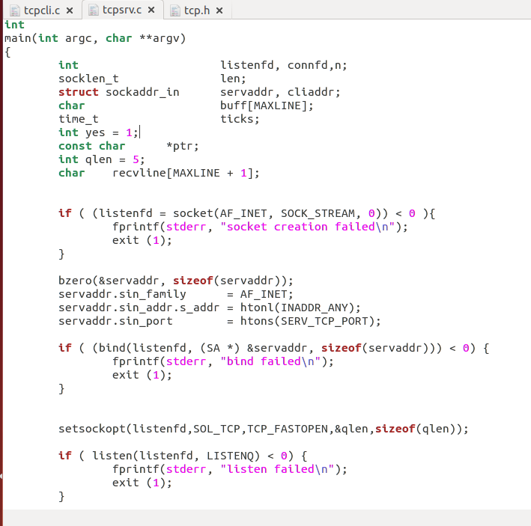
How?
Modfied tcpsrv.c
Standard tcpsrv.c
set a new socket option between bind() and listen()

Slide 59
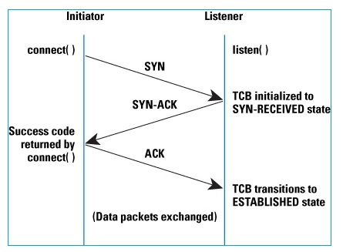
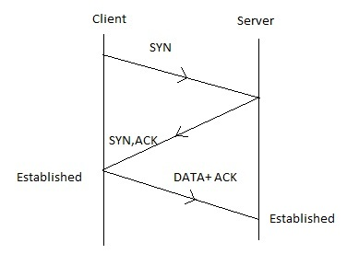
How?
In modified code connection
establishment
TCP connection establishment

Slide 60
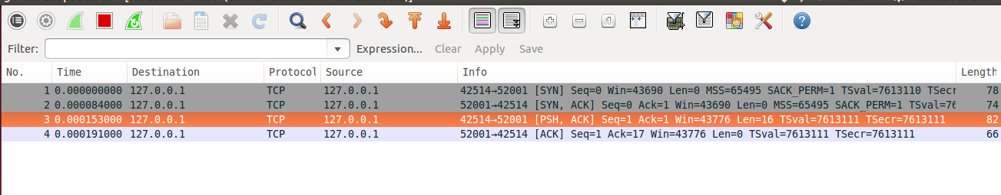
Wireshark Output

Slide 61
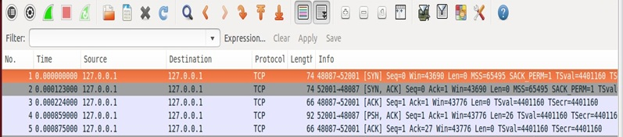
Comparison of Wireshark output: (Standard TCP & Modified TCP)
Standard TCP connection establishment:
Modified TCP connection establishment:

Slide 62
Future Plans – To be Implemented
Analyze the time taken to finish the establishment.
Analyze data transfer speed.

Slide 63
References
[1] B.A. forouzan, “Transmission Control Protocol” in TCP/IP Protocol Suite, 3rd Ed, Mc Graw Hill 2004.
[2] Nandita Dukkipati, Tiziana Refice, Yuchung Cheng, Jerry Chu, Natalia Sutin, Amit Agarwal, Tom Herbert, Arvind Jain “An Argument for Increasing TCP’s Initial Congestion Window”
[4] (2013-05-10). Summary Comparison of TCP/IP Transport Layer Protocols (UDP and TCP) [Online] Available: http://tcpipguide.com
[5] N. Cardwell, S. Savage, and T. Anderson. Modeling TCP Latency. In Proceedings of IEEE Infocom, 2000
Dhammika H De Silva, Dr.Ian Murray “An investigation in to Dynamic TLP’s for Smartphone Communication”, in International Conference on Advances in ICT for emerging regions ICTer, 2013, p.194 – 197

Slide 64
Thank You

